Slide 1



DEPARTMENT OF INFORMATION SCIENCE AND ENGINEERING
Project_Phase-II (BIS786) Presentation
Title: AI-Based Early Alzheimer's Detection and Cognitive Assistance
using Deep Learning
Under the Guidance of
Dr. Anand M
Associate Professor
Department of Information Science
and Engineering
GSSSIETW, Mysuru
Presented by:
Bhavyashree R K [4GW23IS004]
Fouziya Safura [4GW23IS011]
Srinidhi S [4GW23IS052]
Ananya S [4GW24IS400]

Slide 2
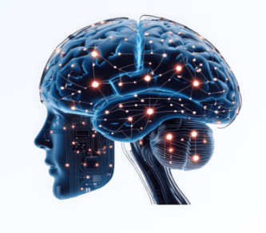
CONTENTS
Title of the Project
2. Introduction
3. Problem Statement
4. Aim & Objectives
5. Related Work (Literature Review)
6. System Requirements:
a. Hardware Requirements
b. Software Requirements
7. Proposed Method
8. Work Carried Out
9. References

Slide 3
INTRODUCTION
Alzheimer’s disease is a progressive neurological disorder that affects memory, thinking ability, and behavior.
It is one of the most common causes of dementia and mainly affects older adults.
In many cases, the disease is diagnosed only after symptoms become severe, making treatment less effective.
Apart from diagnosis, Alzheimer’s patients also require daily support because they may forget medicines, appointments, or even the identity of family members.
To solve these problems, this project proposes a system that combines:
1. Deep learning for early detection
2. GPS tracking for safety
3. Face recognition for identity support
4. Games for cognitive improvement
5. Doctor dashboard for monitoring

Slide 4
PROBLEM STATEMENT
Early detection of Alzheimer’s disease is challenging and requires expert medical assessment.
Patients often face difficulties in medication management, scheduling, cognition, and safety.
Existing solutions generally focus on either disease detection or patient assistance, not both.
Hence, an integrated AI-based system is needed for early detection and continuous caregiver-supported assistance.

Slide 5
AIM AND OBJECTIVES
To design and develop an AI-based system for early detection of Alzheimer’s disease using deep learning and to provide cognitive assistance to patients through a smart application.
To achieve early-stage Alzheimer’s disease detection and classification using CNN-based MRI and CT scan brain image analysis techniques.
To maintain intelligent patient healthcare management through automated reminders, real-time activity monitoring, and doctor-caregiver coordination systems.
To ensure reliable cognitive support using machine learning-based assistance and face recognition techniques for memory enhancement and identity verification.
To develop a smart healthcare monitoring system with GPS tracking, anomaly detection, alert generation, and centralized analytics for continuous patient supervision.

Slide 6
LITERATURE REVIEW
NO | Title | Author(s) | Description | Reference | Year | Limitations
01 | The Role of Artificial Intelligence in the Detection and Diagnosis of Neurocognitive Disorders | Pasqualina Perna, Alessandra Claudi, Fabrizio Stasolla, Raffaele Nappo | AI is used to detect neurocognitive disorders like Alzheimer’s and Mild Cognitive Impairment using data such as neuroimaging, EEG, biomarkers, and speech. It supports early detection, prediction, and patient monitoring. | Technologies MDPI Journal | 2026 | Dataset heterogeneity, lack of external validation, methodological inconsistencies, challenges in clinical implementation, ethical concerns.
02 | AI-Driven Mental Health Support for Caregivers of Individuals With Alzheimer Disease | Syeda Umme Salma, Chandra Rekha Renduchintala, Isa Siddique, Evelina Sterling, Sweta Sneha | AI-based systems use NLP, machine learning, and wearable data to support caregivers of Alzheimer’s patients. They provide personalized monitoring, support,and recommendations. | JMIR Mental Health | 2026 | Lack of personalization in existing systems, limited real-time monitoring, dependency on smart devices, usability challenges, need for explainable AI.

Slide 7
03 | A Deep Learning Model for Early Diagnosis of Alzheimer’s Disease Combined with 3D CNN and Video Swin Transformer | Juan Zhou, Yiming Wei, Xiong Li, Weiqiang Zhou, Ruiyang Tao, Yi Hua, Hongwei Liu | A deep learning model using 3D-CNN and Video Swin Transformer model analyzes MRI images to detect Alzheimer’s. It captures key features, avoids data leakage, and ensures accurate classification. | Scientific Reports | 2025 | Requires high computational power, needs large MRI datasets, complex model architecture, longer training time, limited real-world clinical validation
04 | Facial Expression Deep Learning Algorithms in the Detection of Neurological Disorders | Shania Yoonesi, Ramila Abedi Azar, Melika Arab Bafrani, Shayan Yaghmayee, Haniye Shahavand | CNN-based deep learning analyzes facial expressions to detect neurological disorders. Expression changes act as indicators for accurate AI-based detection | BioMedical Engineering OnLine | 2025 | Limited datasets, variability in facial data, and lack of standardization reduce accuracy. Further validation is required
05 | Enhanced Hybrid AI-Based Framework for Improving the Detection and Diagnosis of Alzheimer’s Disease | Parthasarathi Pattnayak, Tulip Das | Proposes a hybrid AI model using DenseNet and ML classifiers to detect Alzheimer’s from MRI images, achieving good accuracy on 6400 images and supporting automated diagnosis. | IEEE | 2025 | Depends on MRI data quality and size, has high complexity and computational cost, limited clinical validation, and lacks explainability.

Slide 8
06 | A Multi-CNN Ensemble Method for Early Diagnosis of Alzheimer’s Disease Using MRI Imaging | Ghata Mehta, Nitya Jani, Himanshu Gajera, Rajendra Choudhary | Proposes a multi-CNN ensemble model for early Alzheimer’s detection from MRI images, achieving ~99% accuracy and supporting better early diagnosis. | International Conference on Artificial Intelligence and Machine Vision (AIMV), IEEE | 2025 | High computational complexity, depends on large high-quality MRI data, risk of overfitting, low interpretability, and requires extensive clinical validation.
07 | LSTM-Based Assistance for People with Alzheimer’s Disease | Priyanka K, Vikas Benhur Chitla, Aman Aftab, Sumanth Kamath | Focuses on AI assistive tech using LSTM, apps, chatbots, and voice systems to provide reminders, tracking, and personalized care for Alzheimer’s patients. | International Conference on Intelligent and Innovative Technologies in Computing, Electrical and Electronics (IITCEE), IEEE | 2025 | No unified model, multi-tech dependency, privacy concerns, integration challenges, limited deployment, needs personalization.
08 | Early Diagnosis of Alzheimer's Disease Using YOLOv11 Deep Learning Model in MRI Scans | Wided Hechkel, Rim Missaoui, Abdelhamid Helali | Uses YOLOv11 on MRI (ADNI) data to classify four Alzheimer’s stages with high accuracy for early detection. | IEEE 22nd International Multi-Conference on Systems, Signals & Devices (SSD) | 2025 | Needs large MRI dataset, high computation cost, requires clinical validation, accuracy depends on image quality.

Slide 9
09 | Exploring how caregivers of people with Alzheimer’s disease experience role captivity | Wenxia Zhang, Wenting Xu, Junzhi Duan, Junyu Tang, Qunli Zhu, Xifeng Pi, Jing Huang | Examines caregiver burden in Alzheimer’s, highlighting emotional stress, social and financial challenges, and reduced well-being. | International Psychogeriatrics, Elsevier | 2025 | Small sample size, single hospital study, results may not generalize, based on interviews not experiments.
10 | An integrated deep learning model for early and multi-class diagnosis of Alzheimer's disease from MRI scans | Emanuel Raju Vinukonda & B. N. Jagadesh | Proposes a hybrid deep learning system combining IDeepLabV3+, LeNet-5, and EResNext for multi-class Alzheimer’s classification using MRI. | Scientific Reports | 2025 | Requires large datasets and is affected by class imbalance, which can reduce performance.
11 | Artificial Intelligence Technology in Alzheimer’s Disease Research | Wenli Zhang, Yifan Li, Wentao Ren, Bo Liu | Proposes a deep CNN model for Alzheimer’s detection using MRI images from the OASIS dataset with data augmentation to handle class imbalance. The model classifies four dementia stages with ~99.6% accuracy, enabling early automated diagnosis. | Intractable & Rare Diseases Research Journal | 2025 | Requires large datasets, high computational cost, difficulty in early-stage detection, lack of standardized clinical validation, and ethical/privacy concerns.

Slide 10
12 | A novel CNN architecture for accurate early detection and classification of Alzheimer’s disease using MRI data. | A. M. El-Assy, Hanan M. Amer, H. M. Ibrahim, M. A. Mohamed | Proposes a novel CNN architecture for early and multi-class classification of Alzheimer’s disease using MRI brain images. It improves diagnostic accuracy by extracting deep spatial features and effectively classifying different dementia stages. | Scientific Reports | 2024 | The model requires a large amount of high-quality MRI data, and performance may decrease with limited or imbalanced datasets.
13 | MemorySona: Illuminating Cognitive Health with Deep Learning – A Mobile Medical App for Alzheimer’s Patients | Samah A. Z. Hassan | An AI-based Alzheimer’s support system using deep learning models (CNN, DenseNet121, ResNet50, VGG16, InceptionV3) on MRI images for diagnosis. It also provides memory training and reminders, with DenseNet121 achieving the best performance. | 2024 6th International Conference on Computing and Informatics (ICCI), IEEE | 2024 | Accuracy depends on dataset quality, moderate performance, requires large MRI data, limited real-time clinical testing.

Slide 11
14 | Exploring how caregivers of people with Alzheimer’s disease experience role captivity: A qualitative study | Wenxia Zhang, Wenting Xu, Junzhi Duan, Junyu Tang, Qunli Zhu, Xifeng Pi, Jing Huang | Uses AI/ML with clinical and cognitive data to predict Alzheimer’s and MCI, where ensemble methods improve diagnostic accuracy. | International Psychogeriatrics, Elsevier | 2024 | Small sample size, single hospital study, results may not generalize, based on interviews not experiments.
15 | AI-Based Smart Assistant System for Alzheimer Patients | Kiruthika V R, NirmalaDevi J | An AI-based smart assistant uses ML models (LSTM, Random Forest, SVM, LightGBM) to predict activities and provides app-based reminders, tracking, and monitoring to improve patient safety and reduce caregiver burden. | 2024 5th International Conference on Electronics and Sustainable Communication Systems (ICESC), IEEE | 2024 | Depends on user interaction, raises privacy concerns (e.g., location tracking), shows variable accuracy, requires continuous data input.
16 | Deep Learning-Based Diagnosis of Alzheimer’s Disease Using Medical Imaging | Falah Sheikh, Ahmed Al Marouf, Jon George Rokne, Reda Alhajj | Uses deep learning, especially CNN models, for Alzheimer’s detection using MRI and medical imaging data.Shows high classification accuracy and supports early diagnosis with automated feature extraction. | Diagnostics Journal | 2024 | High dependency on imaging data quality, computational cost, limited generalization across datasets, lack of explainability, and need for clinical validation before real-world use.

Slide 12
17 | Early Detection of Alzheimer’s Disease Using Artificial Intelligence and Machine Learning: A Comprehensive Review | Subramanian Ganesan | Reviews AI and Machine Learning methods for early Alzheimer’s detection using MRI, PET, biomarkers, and deep learning models. Shows that multimodal data and hybrid models improve accuracy and support early diagnosis. | VIT University | 2024 | Requires large datasets, high computational power, lack of standardization, clinical validation still needed, ethical and privacy concerns.
18 | Deep Learning-Based Diagnosis of Alzheimer’s Disease Using MRI Images | A. Khan, M.Usman | The model classifies patients into different stages such as Normal, Mild Cognitive Impairment, and Alzheimer’s. It demonstrates improved accuracy compared to traditional machine learning techniques and emphasizes automated feature extraction. | IEEE Access | 2023 | The model’s performance depends heavily on high-quality MRI datasets, requires large amounts of training data, is prone to overfitting with limited samples.
19 | AI-Based Model for Detection and Classification of Alzheimer Disease | Suraj Kumar, Narendra Pratap Singh, Banalaxmi Brahma | Uses CNN on MRI brain images for early Alzheimer’s detection with feature extraction using a pre-trained model.Compares SoftMax, SVM, and DNN classifiers and achieves very high accuracy (~99%), improving early diagnosis. | 2023 IEEE International Conference on Computer Vision and Machine Intelligence (CVMI) | 2023 | Dependence on MRI data quality, risk of overfitting due to very high accuracy, computational complexity, limited dataset diversity and lack of interpretability, and requirement.

Slide 13
20. | Machine Learning Techniques for Alzheimer’s Disease Diagnosis: A Review | S. Rathore, M. Habes, M. A. Iftikhar | This study explores various machine learning algorithms such as Support Vector Machines (SVM), Random Forest, and Logistic Regression for early detection of Alzheimer’s disease, comparing their performance using clinical and imaging datasets. | Elsevier (Journal of Neuroscience Methods) | 2023 | Requires manual feature extraction, is sensitive to data imbalance issues, and has limited capability in capturing complex patterns in high-dimensional data.

Slide 14
SYSTEM REQUIREMENTS
HARDWARE REQUIREMENTS
Processor: Intel i3 / Ryzen 5 or higher
Processor Speed: 1.2 GHz+
RAM: Minimum of 8GB or higher
Hard disk space: 500GB or higher
SOFTWARE REQUIREMENTS
Operating System: Windows 10 or higher
IDE: Visual Studio Code, Android Studio(for mobile app)
Web Stack: React.js, HTML,CSS, JavaScript(Frontend) Node.js, Express.js(Backend)
Deep Learning Frameworks: scikit-learn, TensorFlow, Keras
Programming Language: Python
Libraries: OpenCV (image processing), NumPy, Pandas
Database: MongoDB
Data Visualization Tool: matplotlib (for displaying dashboards)

Slide 15
PROPOSED METHODOLOGY
1. Data Collection
MRI brain scan images are collected from standard datasets.
The collected images are stored, prepared and organised for further analysis.
2. Data Preprocessing
Images are resized to a fixed size, converted to grayscale, and normalized.
Noise removal techniques are applied to improve image quality, and the dataset is split into training and testing sets.
3. Model Development (CNN)
A CNN is designed to automatically extract important features from MRI brain images.
The model learns hidden patterns associated with Alzheimer’s disease during training.
4. Model Training and Evaluation
The CNN model is trained using the processed MRI dataset and tested for performance.
Evaluate EfficientNet as a transfer-learning-based architecture for improved feature extraction and classification.
Accuracy and other evaluation metrics are used to optimize the model.

Slide 16
5. Prediction System
The trained system accepts a new MRI brain scan as input and automatically predicts the stage of Alzheimer’s disease as Normal, Mild, Moderate, or Severe.
Integrate the selected trained model with the application backend.
6. Healthcare Application
Develop Caregiver and Doctor dashboards.
Provide medication alerts, scheduling and cognitive assistance.
7. Mobile Application Integration
The trained model is connected to an Android application.
The app provides medications reminders, daily activity alerts, and safety notifications for patients.
8. Result and Monitoring
Prediction results are displayed clearly in the app.
Patient history is stored to help doctors and caregivers monitor progress.

Slide 17
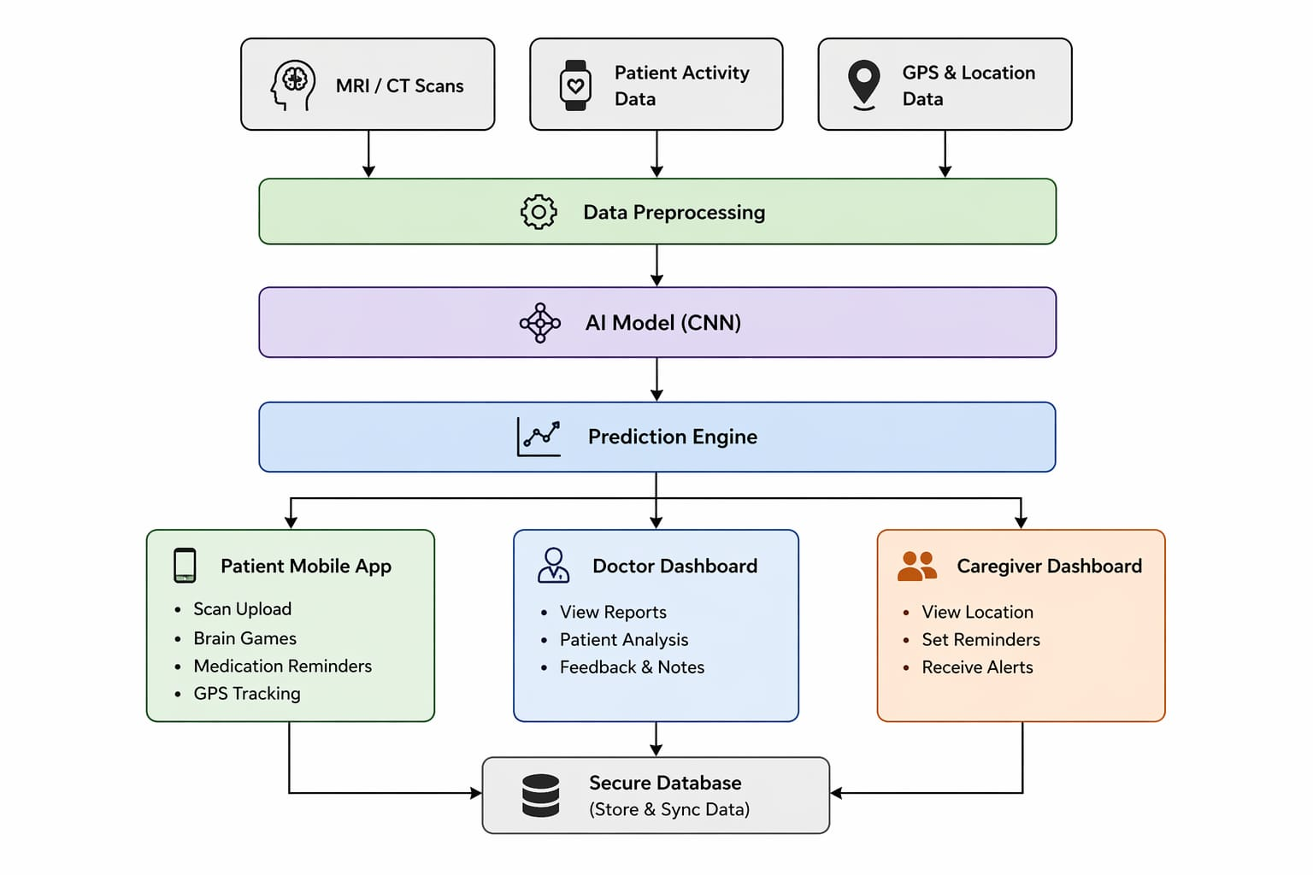
SYSTEM ARCHITECTURE

Slide 18
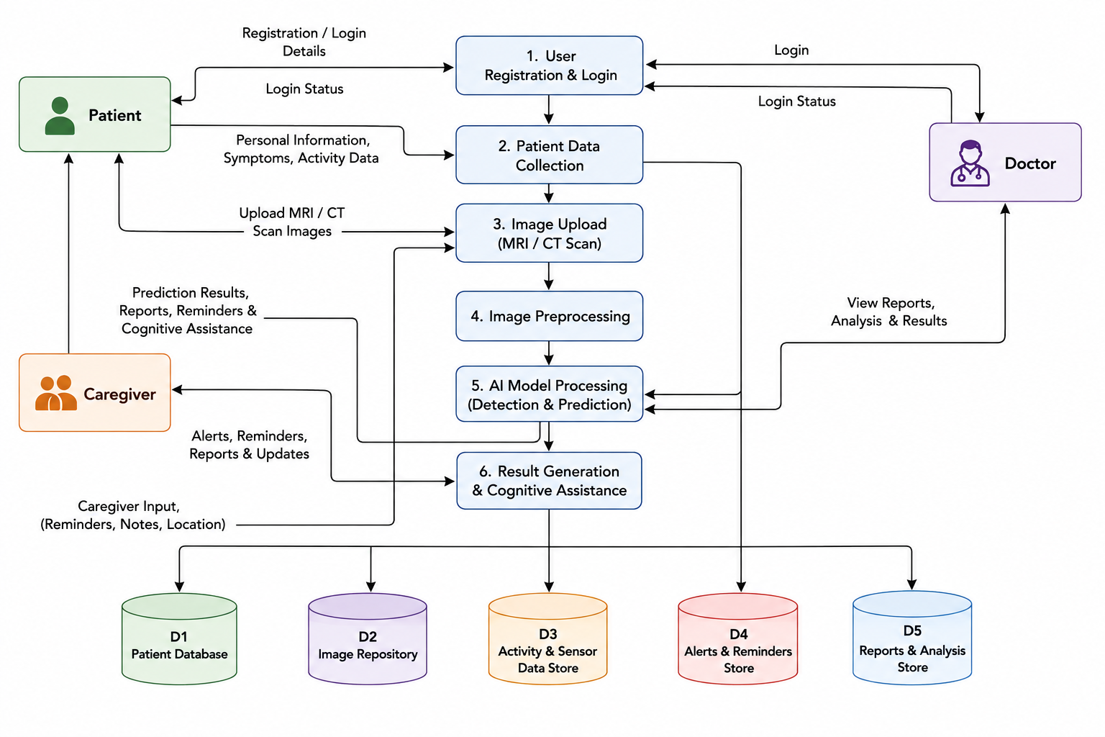
DATA FLOW DIAGRAM

Slide 19
WORK CARRIED OUT
Designed the overall system architecture and modular workflow for AI-based Alzheimer’s detection.
Prepared the dataset with resizing, normalization and augmentation for training.
Developed and evaluated CNN-based Alzheimer’s classification; EfficientNet Model is used for transfer learning.
Implemented Doctor & Caregiver registration, login and authentication with role-based access.
Developed Doctor and Caregiver dashboards with patient information management.
Developed REST APIs using Node.js/Express.js and integrated MongoDB Atlas.
Integrated medication reminders, scheduling and cognitive assistance.
AI prediction integration and advanced safety features (Face Recognition, GPS, anomaly detection & alerts) are under development.

Slide 20
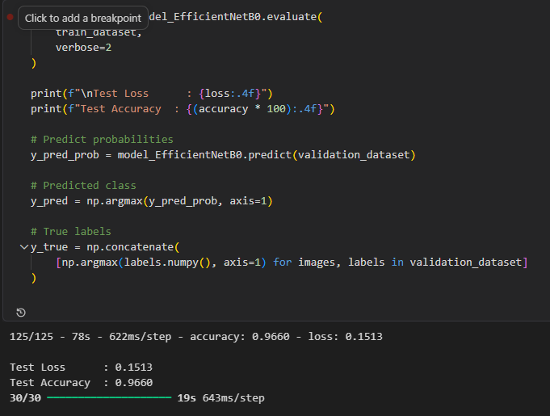
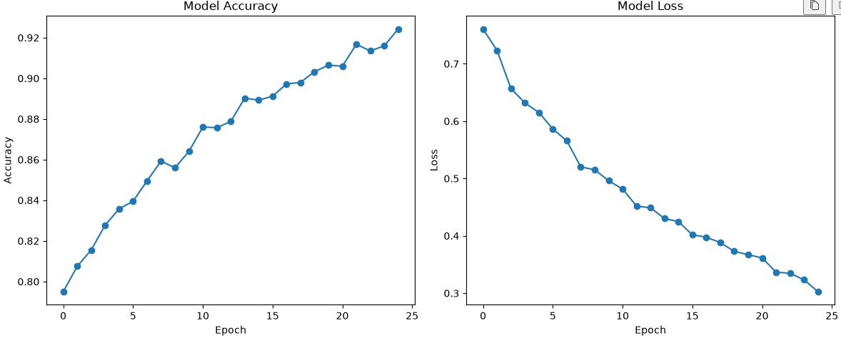
WORK CARRIED OUT – MODEL TRAINING

Slide 21
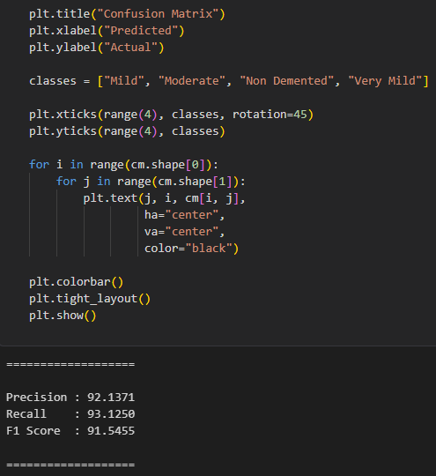
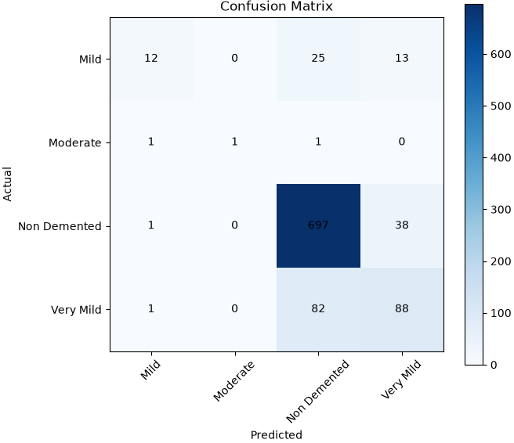
Observed Metrics:
Accuracy: 96.60
Precision: 93.13
Recall: 93.12
F1 Score: 91.54

Slide 22
REFERENCES
[1] Pasqualina Perna, Alessandra Claudi, Fabrizio Stasolla, Raffaele Nappo. The Role of Artificial Intelligence in the Detection and Diagnosis of Neurocognitive Disorders. MDPI Journal, Vol. 13(1), 2026.
[2] Syeda Umme Salma, Chandra Rekha Renduchintala, Isa Siddique, Evelina Sterling, Sweta Sneha. AI-Driven Mental Health Support for Caregivers of Individuals With Alzheimer Disease. JMIR Mental Health, 2026.
[3] Juan Zhou, Yiming Wei, Xiong Li, Weiqiang Zhou, Ruiyang Tao, Yi Hua, Hongwei Liu. A Deep Learning Model for Early Diagnosis of Alzheimer’s Disease Combined with 3D CNN and Video Swin Transformer. Scientific Reports, 2025.
[4] Shania Yoonesi, Ramila Abedi Azar, Melika Arab Bafrani, Shayan Yaghmayee, Haniye Shahavand. Facial Expression Deep Learning Algorithms in the Detection of Neurological Disorders. BioMedical Engineering OnLine, 2025.
[5] Parthasarathi Pattnayak, Tulip Das. Enhanced Hybrid AI-Based Framework for Improving the Detection and Diagnosis of Alzheimer’s Disease. IEEE, 2025.

Slide 23
[6] Ghata Mehta, Nitya Jani, Himanshu Gajera, Rajendra Choudhary. A Multi-CNN Ensemble Method for Early Diagnosis of Alzheimer’s Disease Using MRI Imaging. International Conference on Artificial Intelligence and Machine Vision (AIMV), IEEE, 2025.
[7] Priyanka K, Vikas Benhur Chitla, Aman Aftab, Sumanth Kamath. LSTM-Based Assistance for People with Alzheimer’s Disease. International Conference on Intelligent and Innovative Technologies in Computing, Electrical and Electronics (IITCEE), IEEE, 2025.
[8] Wided Hechkel, Rim Missaoui, Abdelhamid Helali. Early Diagnosis of Alzheimer's Disease Using YOLOv11 Deep Learning Model in MRI Scans. IEEE 22nd International Multi-Conference on Systems, Signals & Devices (SSD), 2025.
[9] Wenxia Zhang, Wenting Xu, Junzhi Duan, Junyu Tang, Qunli Zhu, Xifeng Pi, Jing Huang. Exploring how caregivers of people with Alzheimer’s disease experience role captivity. International Psychogeriatrics, Elsevier, 2025.
[10] Emanuel Raju Vinukonda & B. N. Jagadesh. An integrated deep learning model for early and multi-class diagnosis of Alzheimer's disease from MRI scans. Scientific Reports, 2025.

Slide 24
[11] Wenli Zhang, Yifan Li, Wentao Ren, Bo Liu. Artificial Intelligence Technology in Alzheimer’s Disease Research. Intractable & Rare Diseases Research Journal, 2025.
[12] A. M. El-Assy, Hanan M. Amer, H. M. Ibrahim, and M. A. Mohamed. A novel CNN architecture for accurate early detection and classification of Alzheimer’s disease using MRI data. Scientific Reports, 2024.
[13] Samah A. Z. Hassan. MemorySona: Illuminating Cognitive Health with Deep Learning – A Mobile Medical App for Alzheimer’s Patients. 2024 6th International Conference on Computing and Informatics (ICCI), IEEE, 2024.
[14] Wenxia Zhang, Wenting Xu, Junzhi Duan, Junyu Tang, Qunli Zhu, Xifeng Pi, Jing Huang. Exploring how caregivers of people with Alzheimer’s disease experience role captivity: A qualitative study. International Psychogeriatrics, Elsevier, 2024.
[15] Kiruthika V R, NirmalaDevi J. AI-Based Smart Assistant System for Alzheimer Patients. 2024 5th International Conference on Electronics and Sustainable Communication Systems (ICESC), IEEE, 2024.
[16] Falah Sheikh, Ahmed Al Marouf, Jon George Rokne, Reda Alhajj. Deep Learning-Based Diagnosis of Alzheimer’s Disease Using Medical Imaging. Diagnostics Journal, 2024.

Slide 25
[17] Subramanian Ganesan. Early Detection of Alzheimer’s Disease Using Artificial Intelligence and Machine Learning: A Comprehensive Review. VIT University, 2024.
[18] Wenli Zhang, Yifan Li, Wentao Ren, Bo Liu. Artificial Intelligence Technology in Alzheimer’s Disease Research. Intractable & Rare Diseases Research, 2023.
[19] A. Khan, S. Hussain, M. Usman, et al., Deep Learning-Based Classification of Alzheimer’s Disease Using MRI Data, IEEE Access, 2023.
[20] S. Rathore, M. Habes, M. A. Iftikhar, Machine Learning Techniques for Alzheimer’s Disease Diagnosis: A Review, Elsevier (Journal of Neuroscience Methods), 2023.

Slide 26
THANK YOU

